Slide 1


QARM II Project
Trend Following, Momentum Crash and High Correlations
Maxime Borel & Benjamin Souane

Slide 2



Agenda
Introduction
Data & Investment Universe
Methodology
Benchmarks
Results & Sensitivity Analysis
Limits and Recommendation
Maxime Borel & Benjamin Souane
QARM II – 17.12.2020
Notes:
B

Slide 3

Introduction – Context
Trend Following
Mandate
Cross-Assets Portfolio
Low cost
Momentum reversals & High correlations
Trend in the Market
Machine Learning
Maxime Borel & Benjamin Souane
QARM II – 17.12.2020
Notes:
B

Slide 4












Data & Investment Universe
Dataset 01.1998 – 08.2020
Provider - Thomson Reuters Datastream
Worldwide -
Assets Classes
Equity Indices
Commodities -
FX pairs
Sovereign Bonds
Investment Vehicle - Continuous Future
Investable - Daily data with monthly rebalancing
Maxime Borel & Benjamin Souane
QARM II – 17.12.2020
Notes:
Money neutrality to mention in Continous future
M

Slide 5
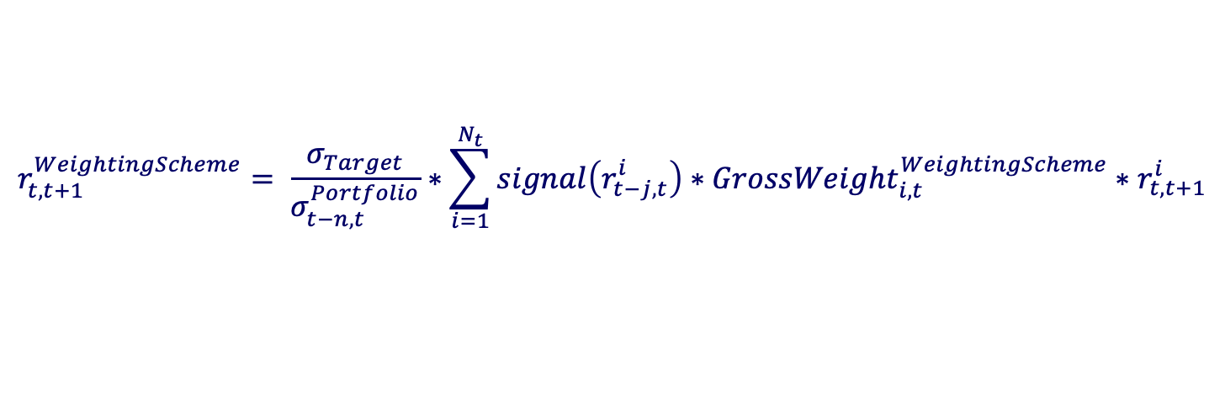
Methodology
How do we implemented the Trend following ?
$$r_{t,t+1}^{WeightingScheme}= \frac{σ_{Target}}{σ_{t−n,t}^{Portfolio}}∗\sum_{i=1}^{N_{t}}{signal\left(r_{t−j,t}^{i}\right)∗GrossWeight_{i,t}^{WeightingScheme}∗r_{t,t+1}^{i}}$$
Scaling factor
Momentum
Moving Average
EWMA
SSA
SVM
Equally Weighted
Volatility Parity
Risk Parity
Maxime Borel & Benjamin Souane
QARM II – 17.12.2020
Notes:
M

Slide 6

Benchmarks – Framework
Momentum & Moving average
Momentum
252
90 & 90JUMP
Moving Average
21days – 63 days
Volatility target - 10%
Maxime Borel & Benjamin Souane
QARM II – 17.12.2020

Slide 7
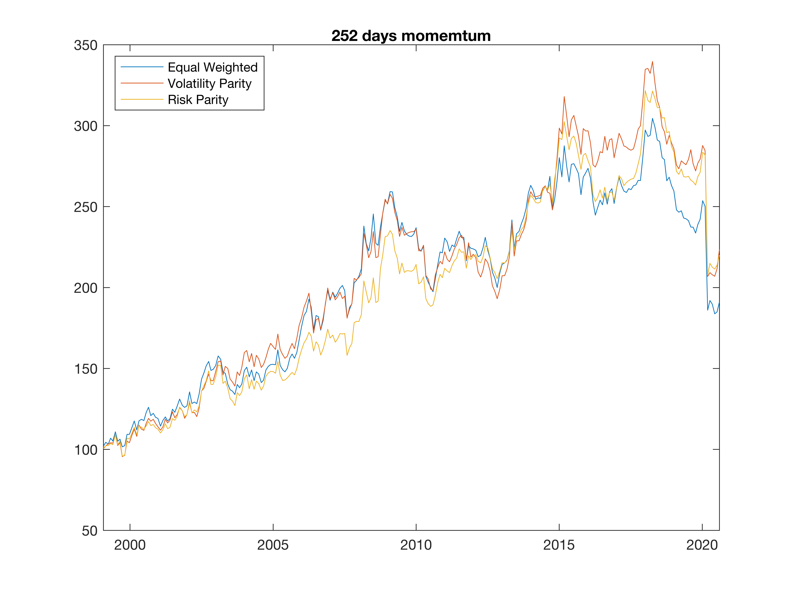
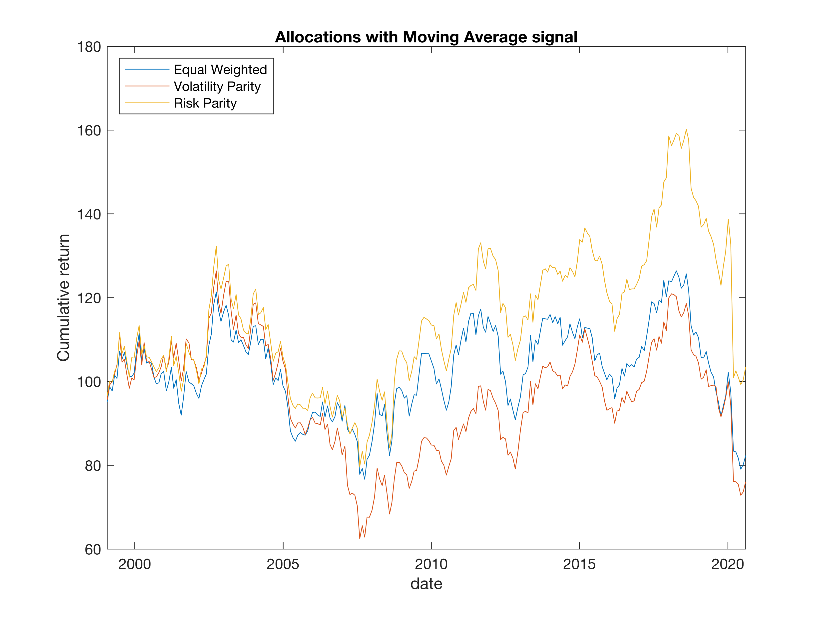
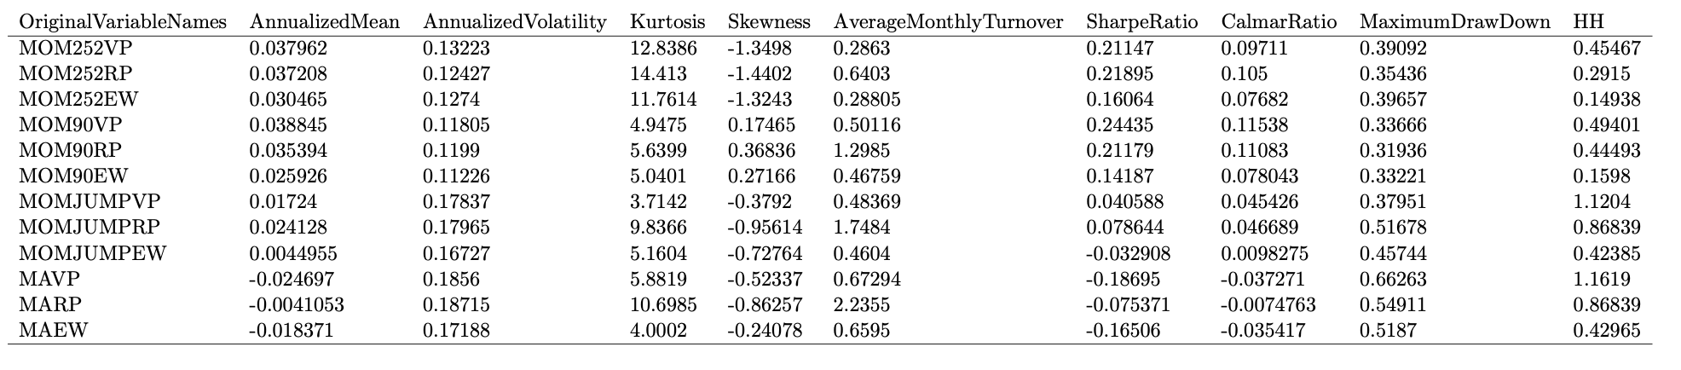
Benchmarks – Results
Momentum & Moving average
Maxime Borel & Benjamin Souane
QARM II – 17.12.2020

Slide 8
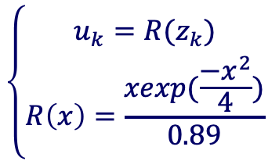
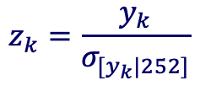
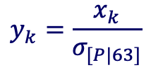
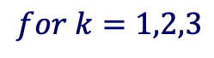
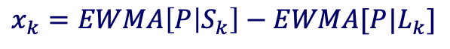
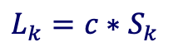
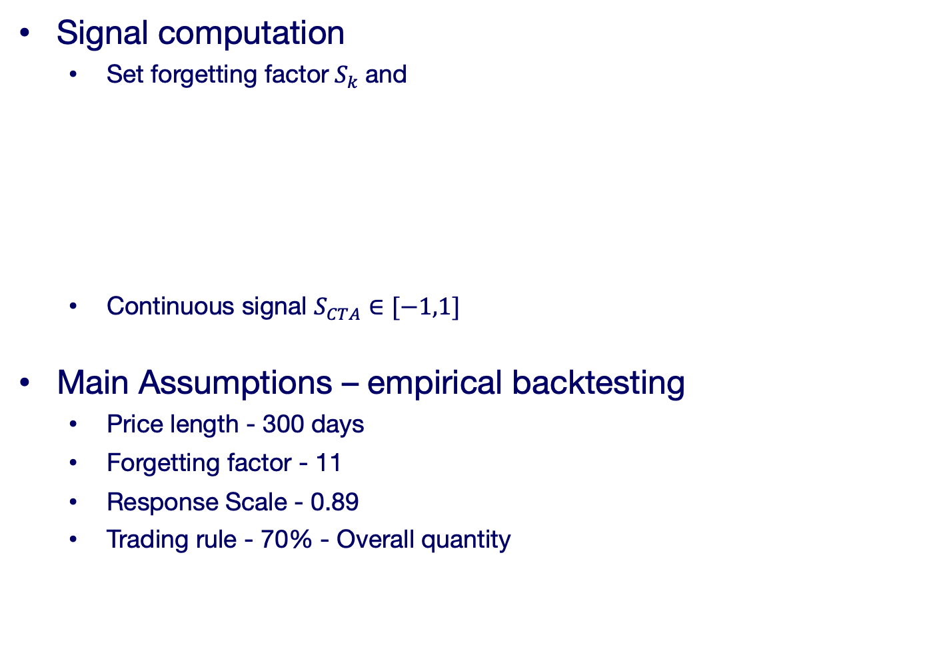
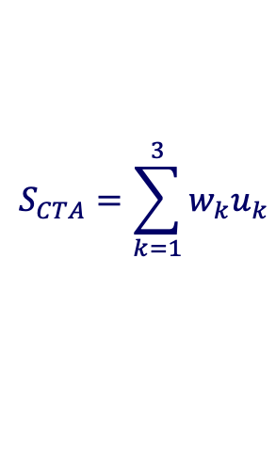
Results – EWMA - Framework
Signal and assumptions
Signal computation
Set forgetting factor${ S}_{k}$and
Continuous signal $S_{CTA}∈[−1,1]$
Main Assumptions – empirical backtesting
Price length - 300 days
Forgetting factor - 11
Response Scale - 0.89
Trading rule - 70% - Overall quantity
$$L_{k}={c∗S}_{k}$$
$$for k=1,2,3$$
$$x_{k}=EWMA\left[P | S_{k}\right]−EWMA[P|L_{k}]$$
$$\left\{\begin{aligned}u_{k}=R(z_{k}) \\ R\left(x\right)=\frac{xexp(\frac{−x^{2}}{4})}{0.89}\end{aligned}\right.$$
$$y_{k}=\frac{x_{k}}{σ_{[P|63]}}$$
$$S_{CTA}=\sum_{k=1}^{3}{w_{k}u_{k}}$$
$$z_{k}=\frac{y_{k}}{σ_{[y_{k}|252]}}$$
Maxime Borel & Benjamin Souane
QARM II – 17.12.2020

Slide 9
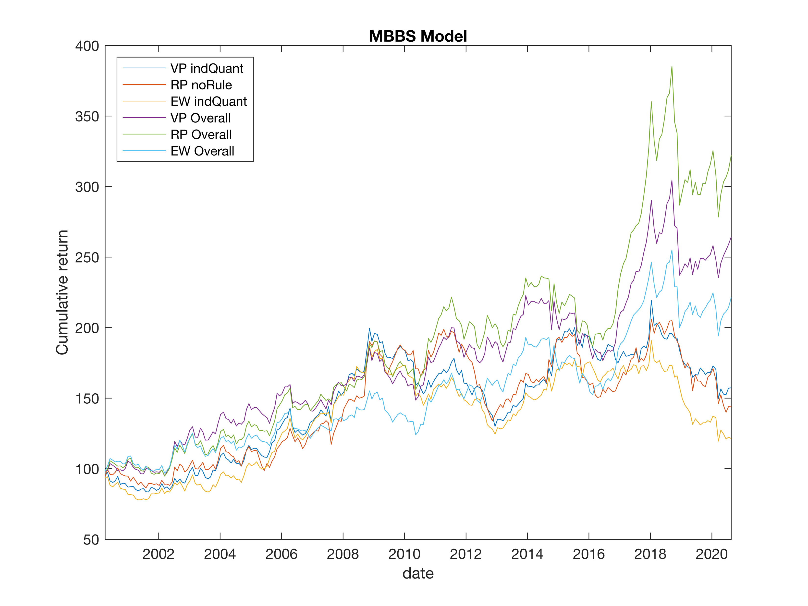
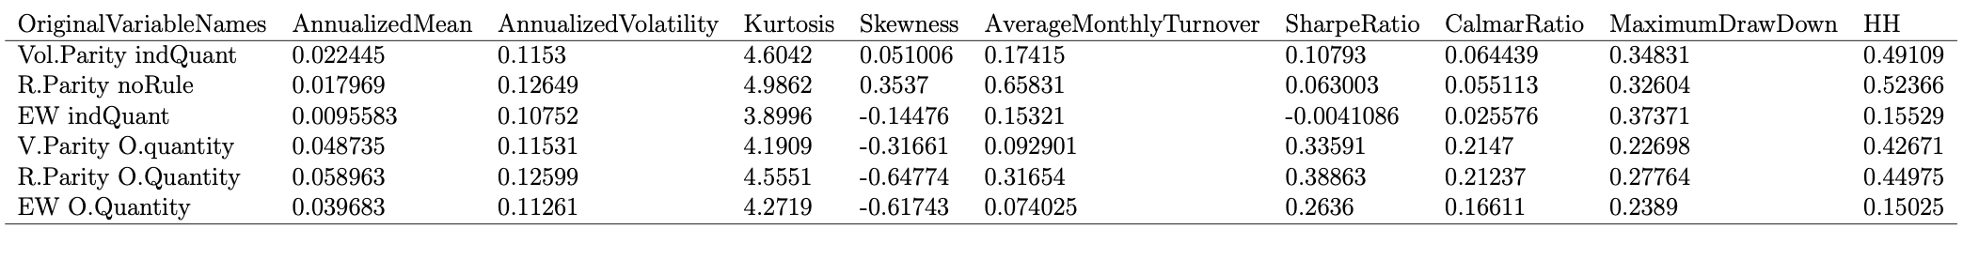
Results – EWMA - Performance
Maxime Borel & Benjamin Souane
QARM II – 17.12.2020
Maxime Borel & Benjamin Souane

Slide 10
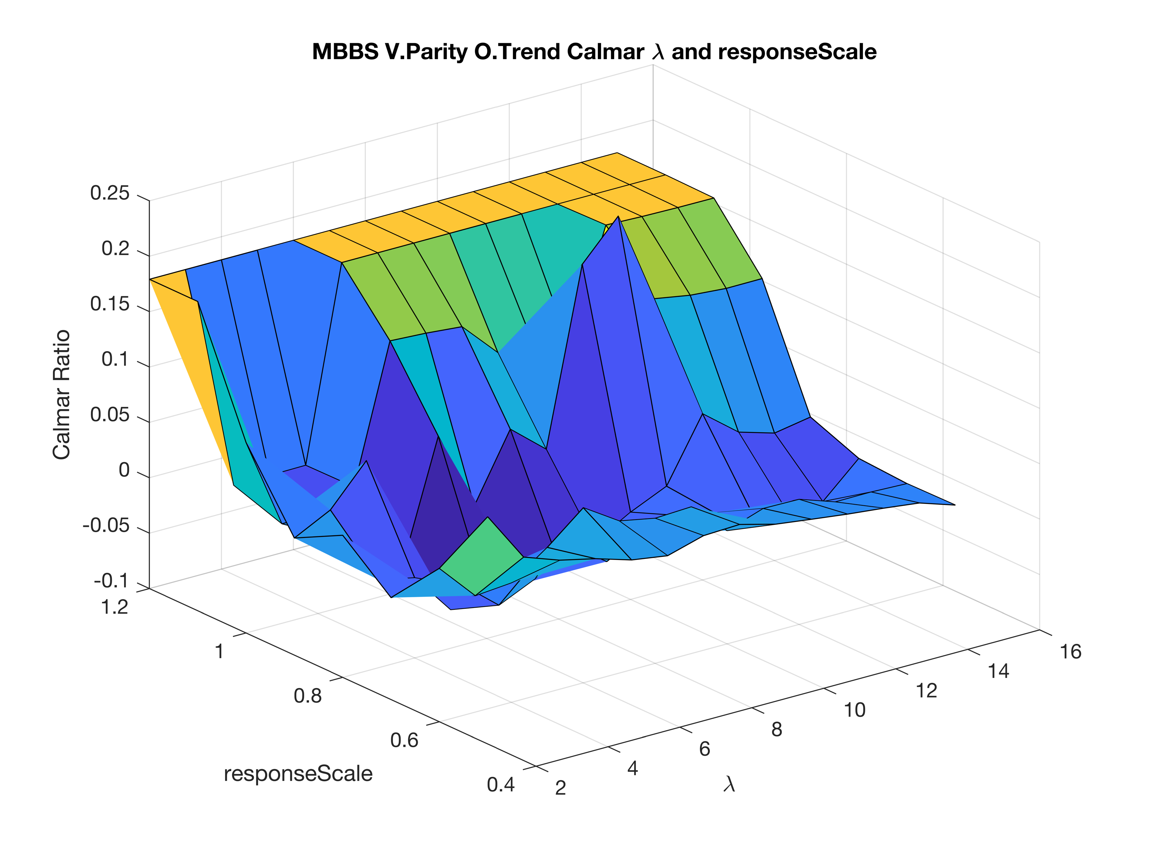
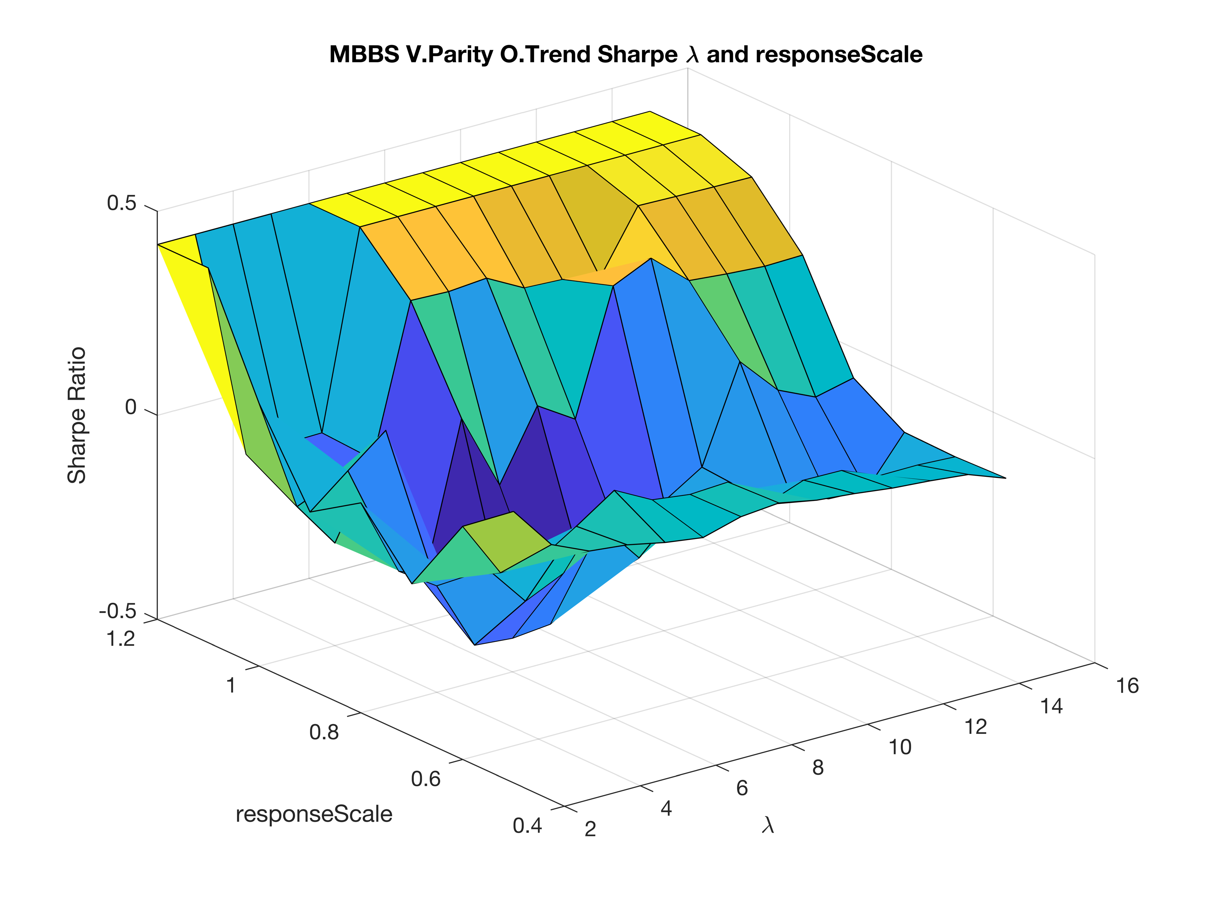
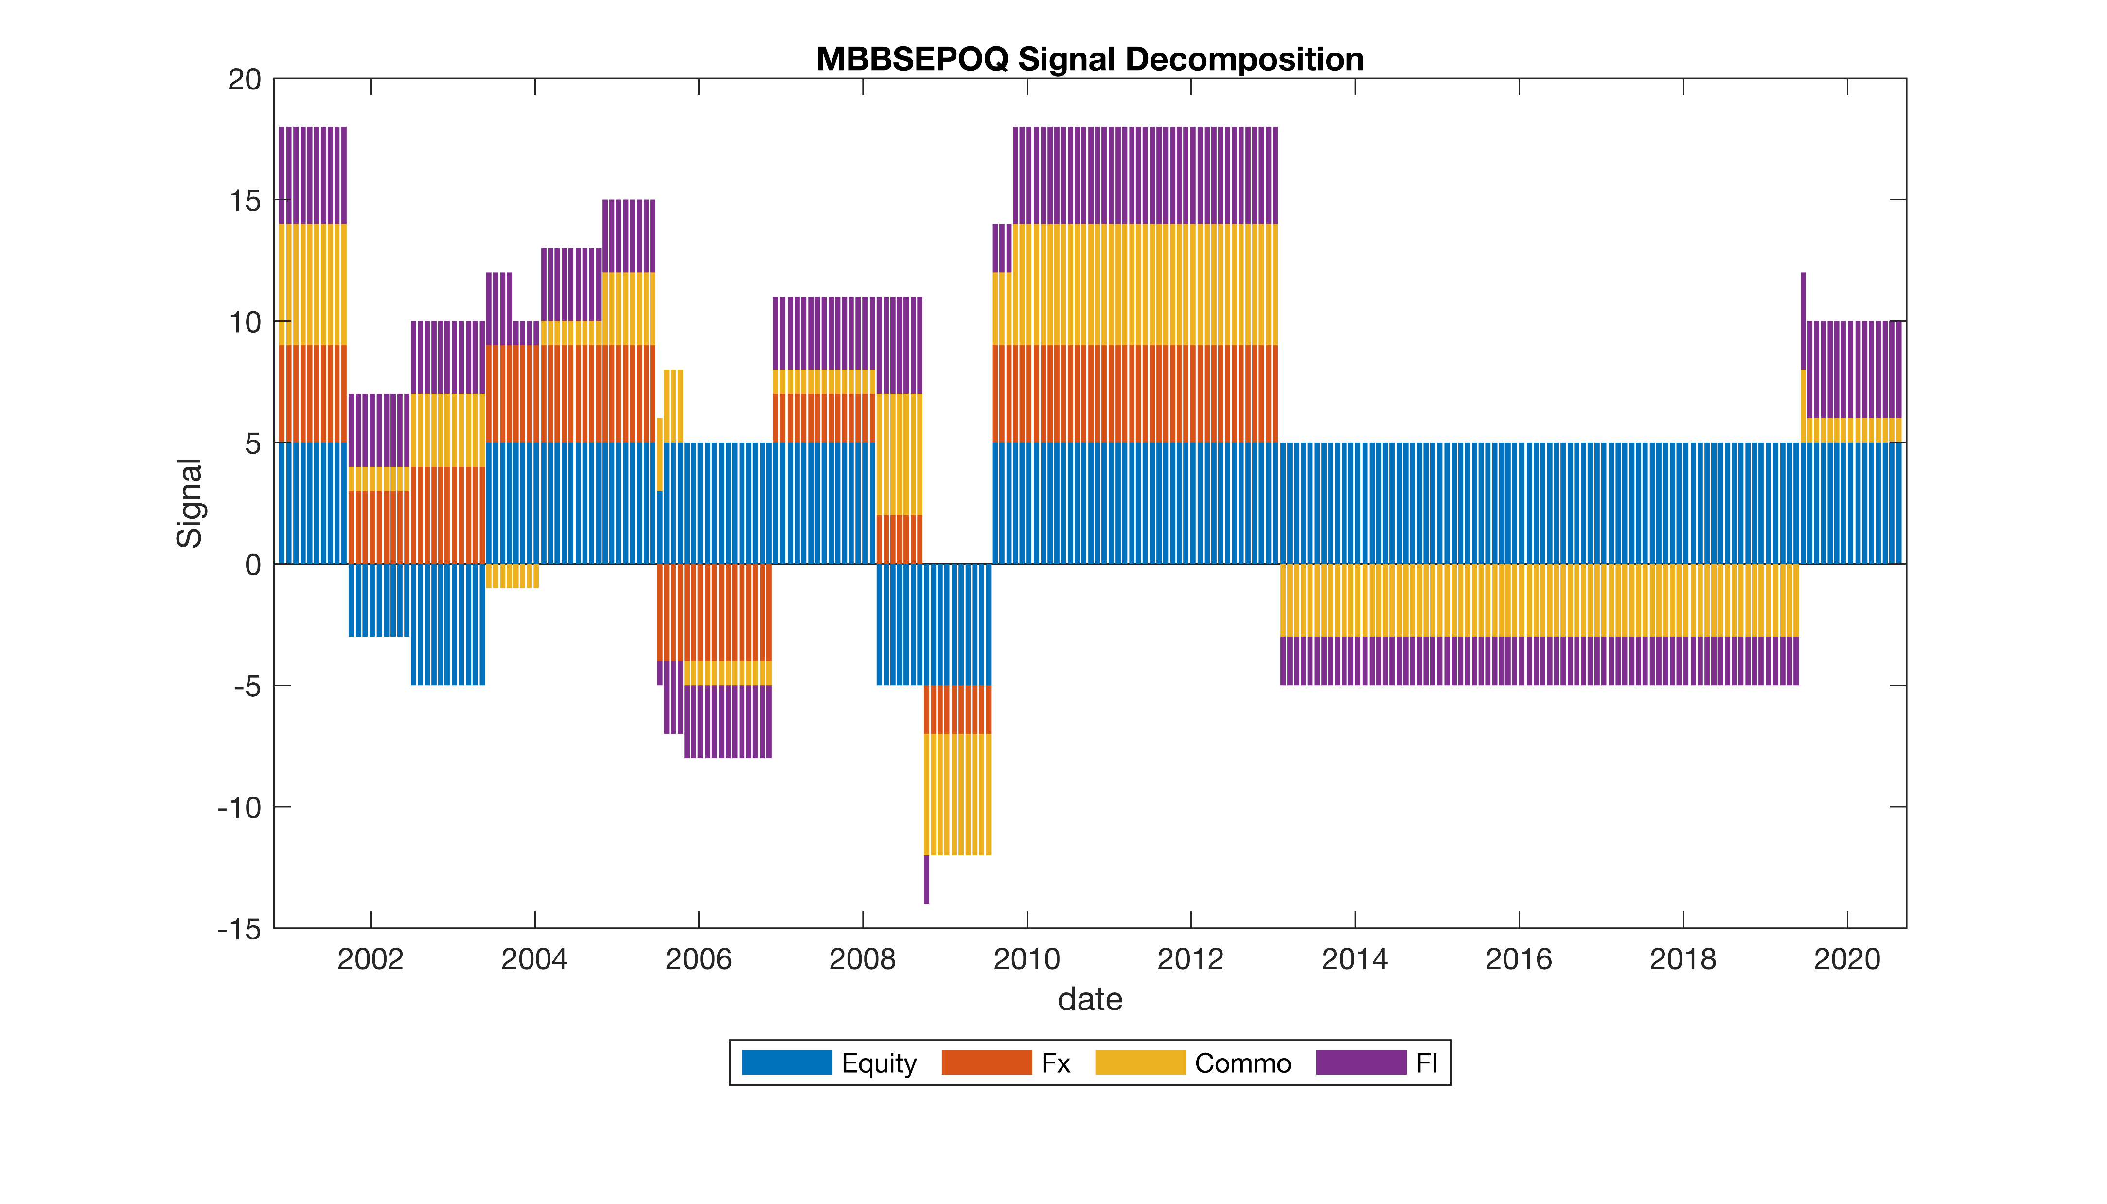
Results – EWMA – Sensitivity Analysis
Impact of the trading rule
Maxime Borel & Benjamin Souane
QARM II – 17.12.2020

Slide 11

Results – EWMA – Conclusion
Conclusion
Better than momentum
Almost neutral to correlation
Trading rule helps a lot but …
Highly sensitive model
Maxime Borel & Benjamin Souane
QARM II – 17.12.2020

Slide 12

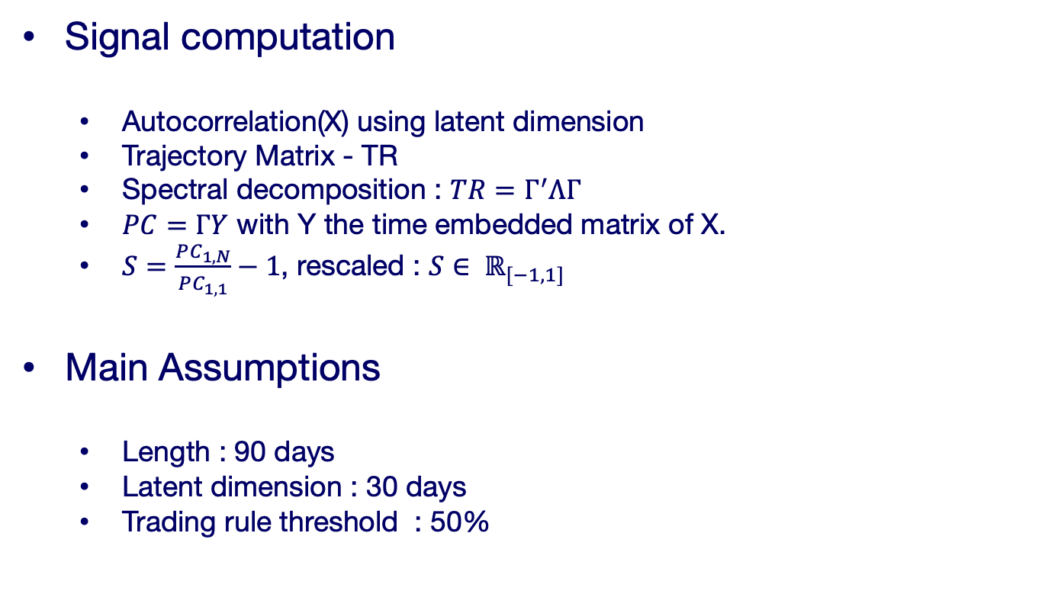
Results – SSA - Framework
Signal and assumptions
Signal computation
Autocorrelation(X) using latent dimension
Trajectory Matrix - TR
Spectral decomposition : $TR=Γ^{′}ΛΓ$
$PC=ΓY$ with Y the time embedded matrix of X.
$S=\frac{PC_{1,N}}{PC_{1,1}}−1$, rescaled : $S∈ ℝ_{[−1,1] }$
Main Assumptions
Length : 90 days
Latent dimension : 30 days
Trading rule threshold : 50%
Maxime Borel & Benjamin Souane
QARM II – 17.12.2020

Slide 13
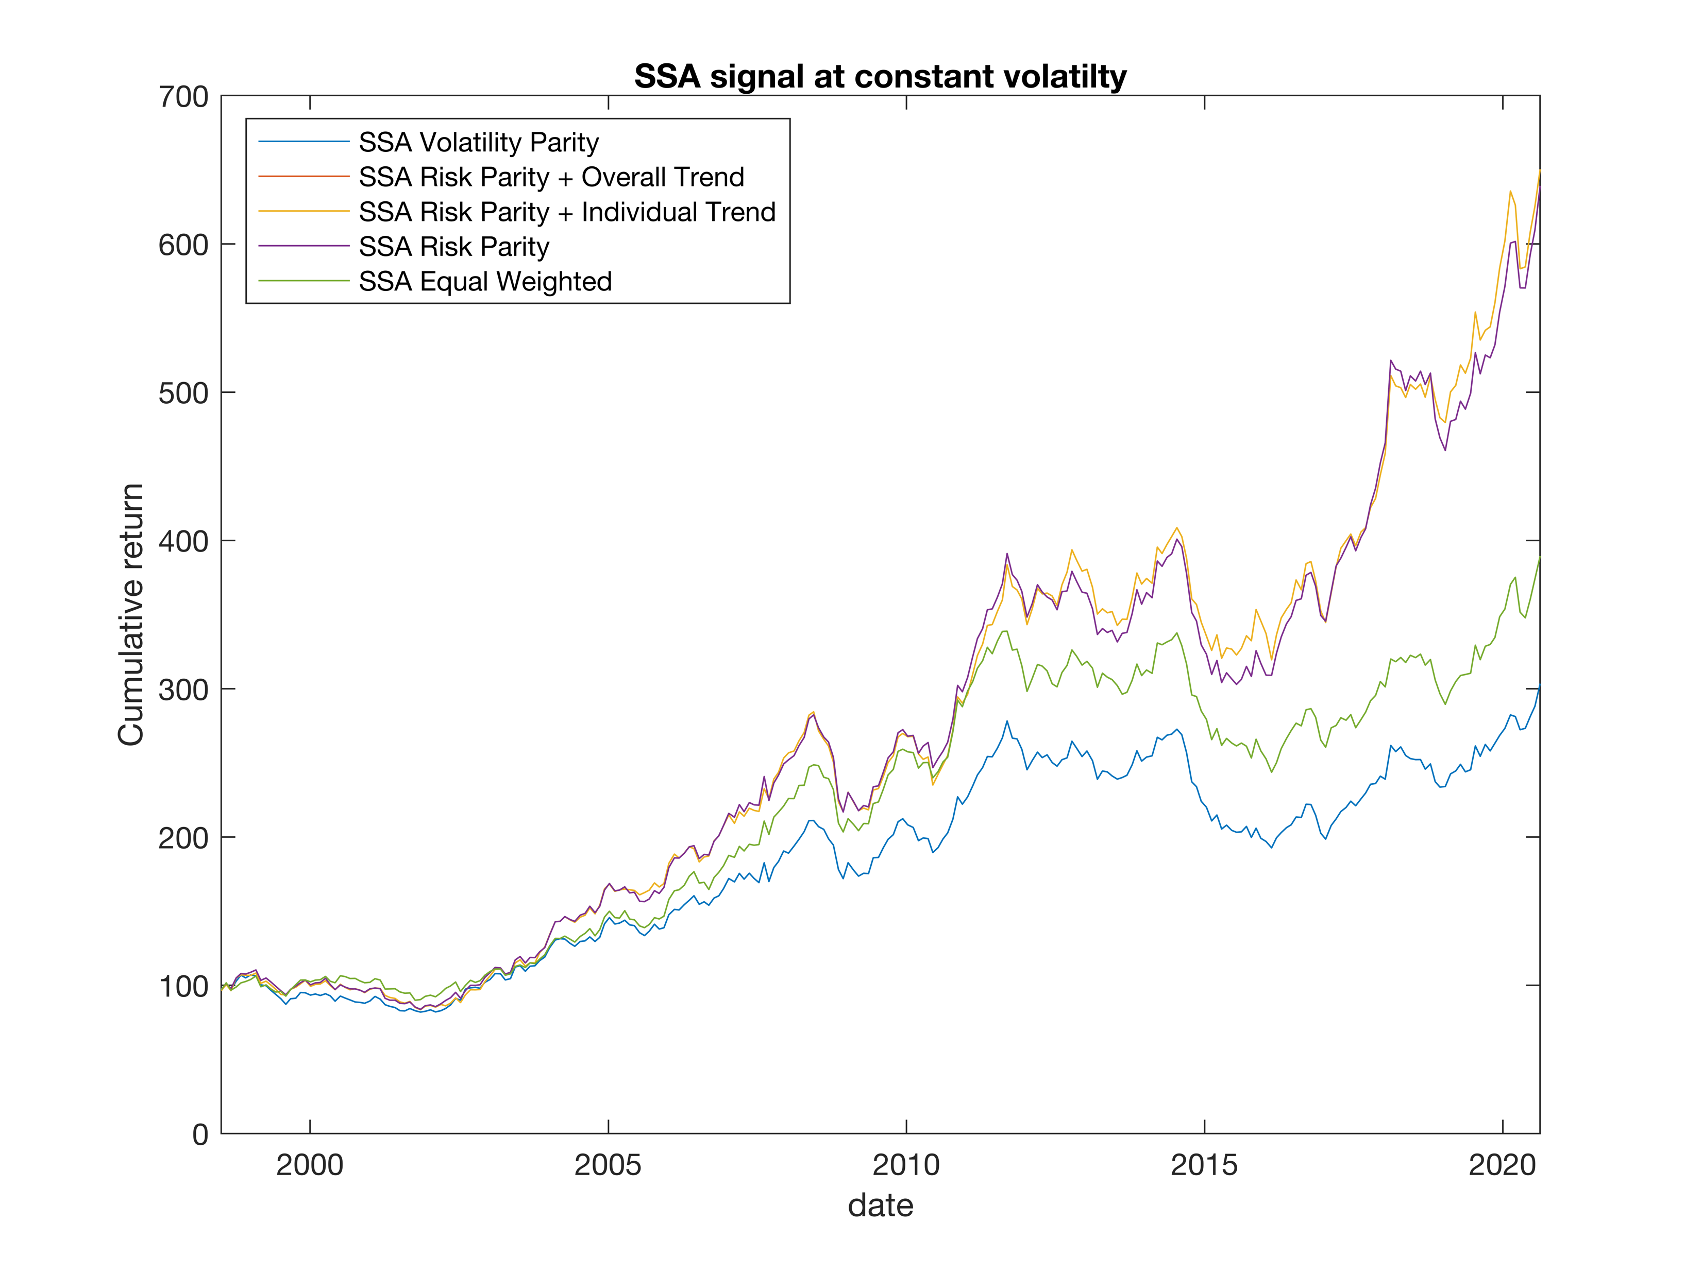
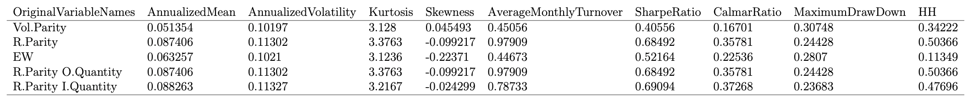
Results – SSA - Performance
Maxime Borel & Benjamin Souane
QARM II – 17.12.2020

Slide 14
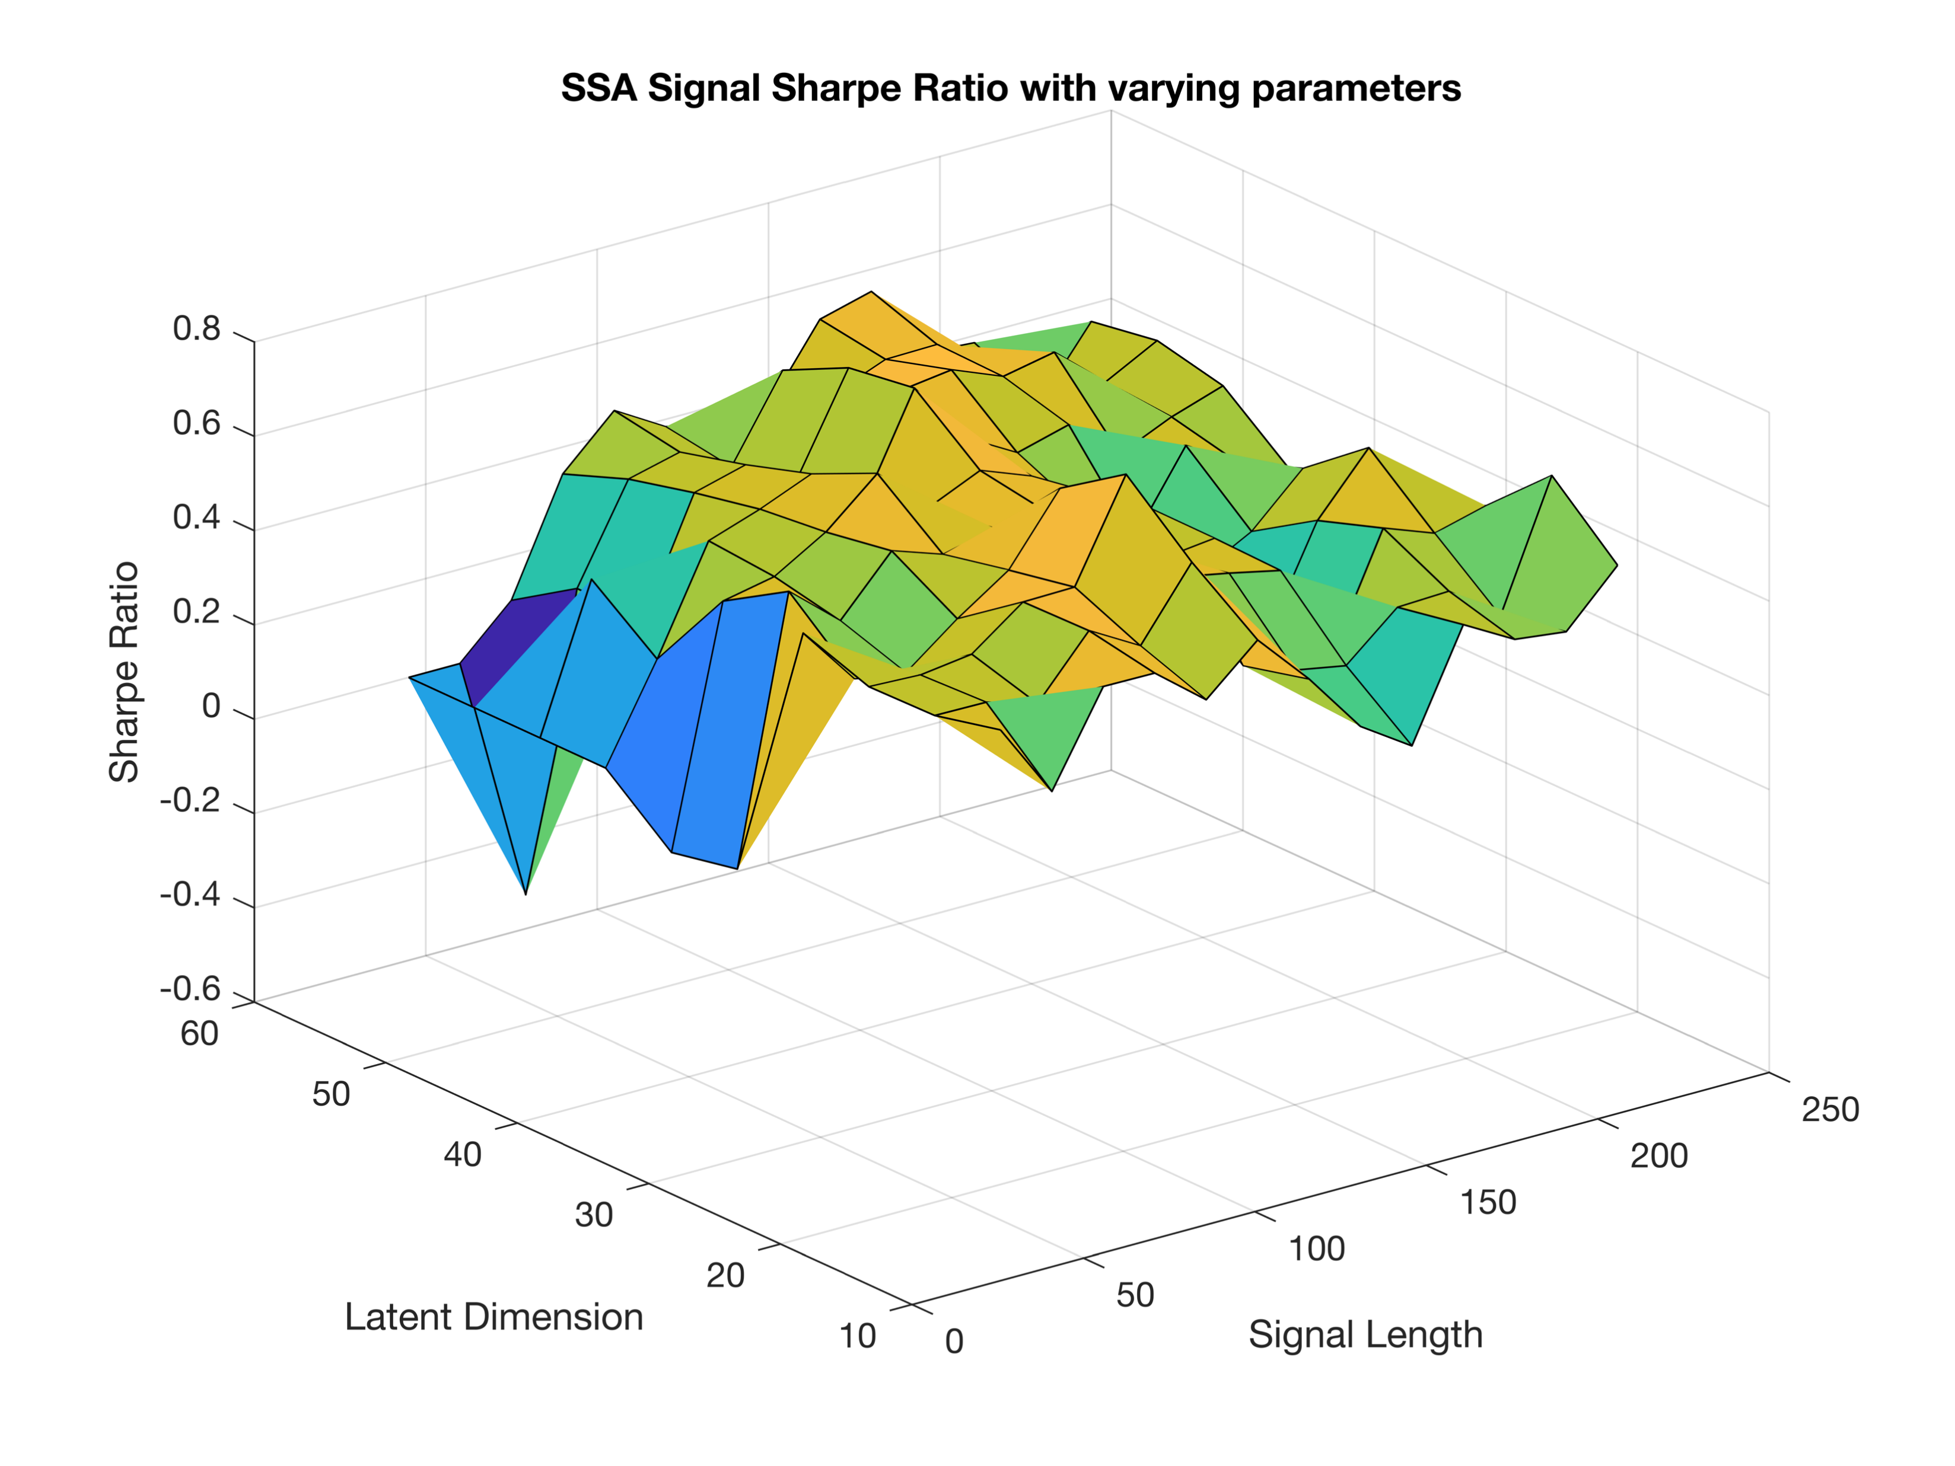
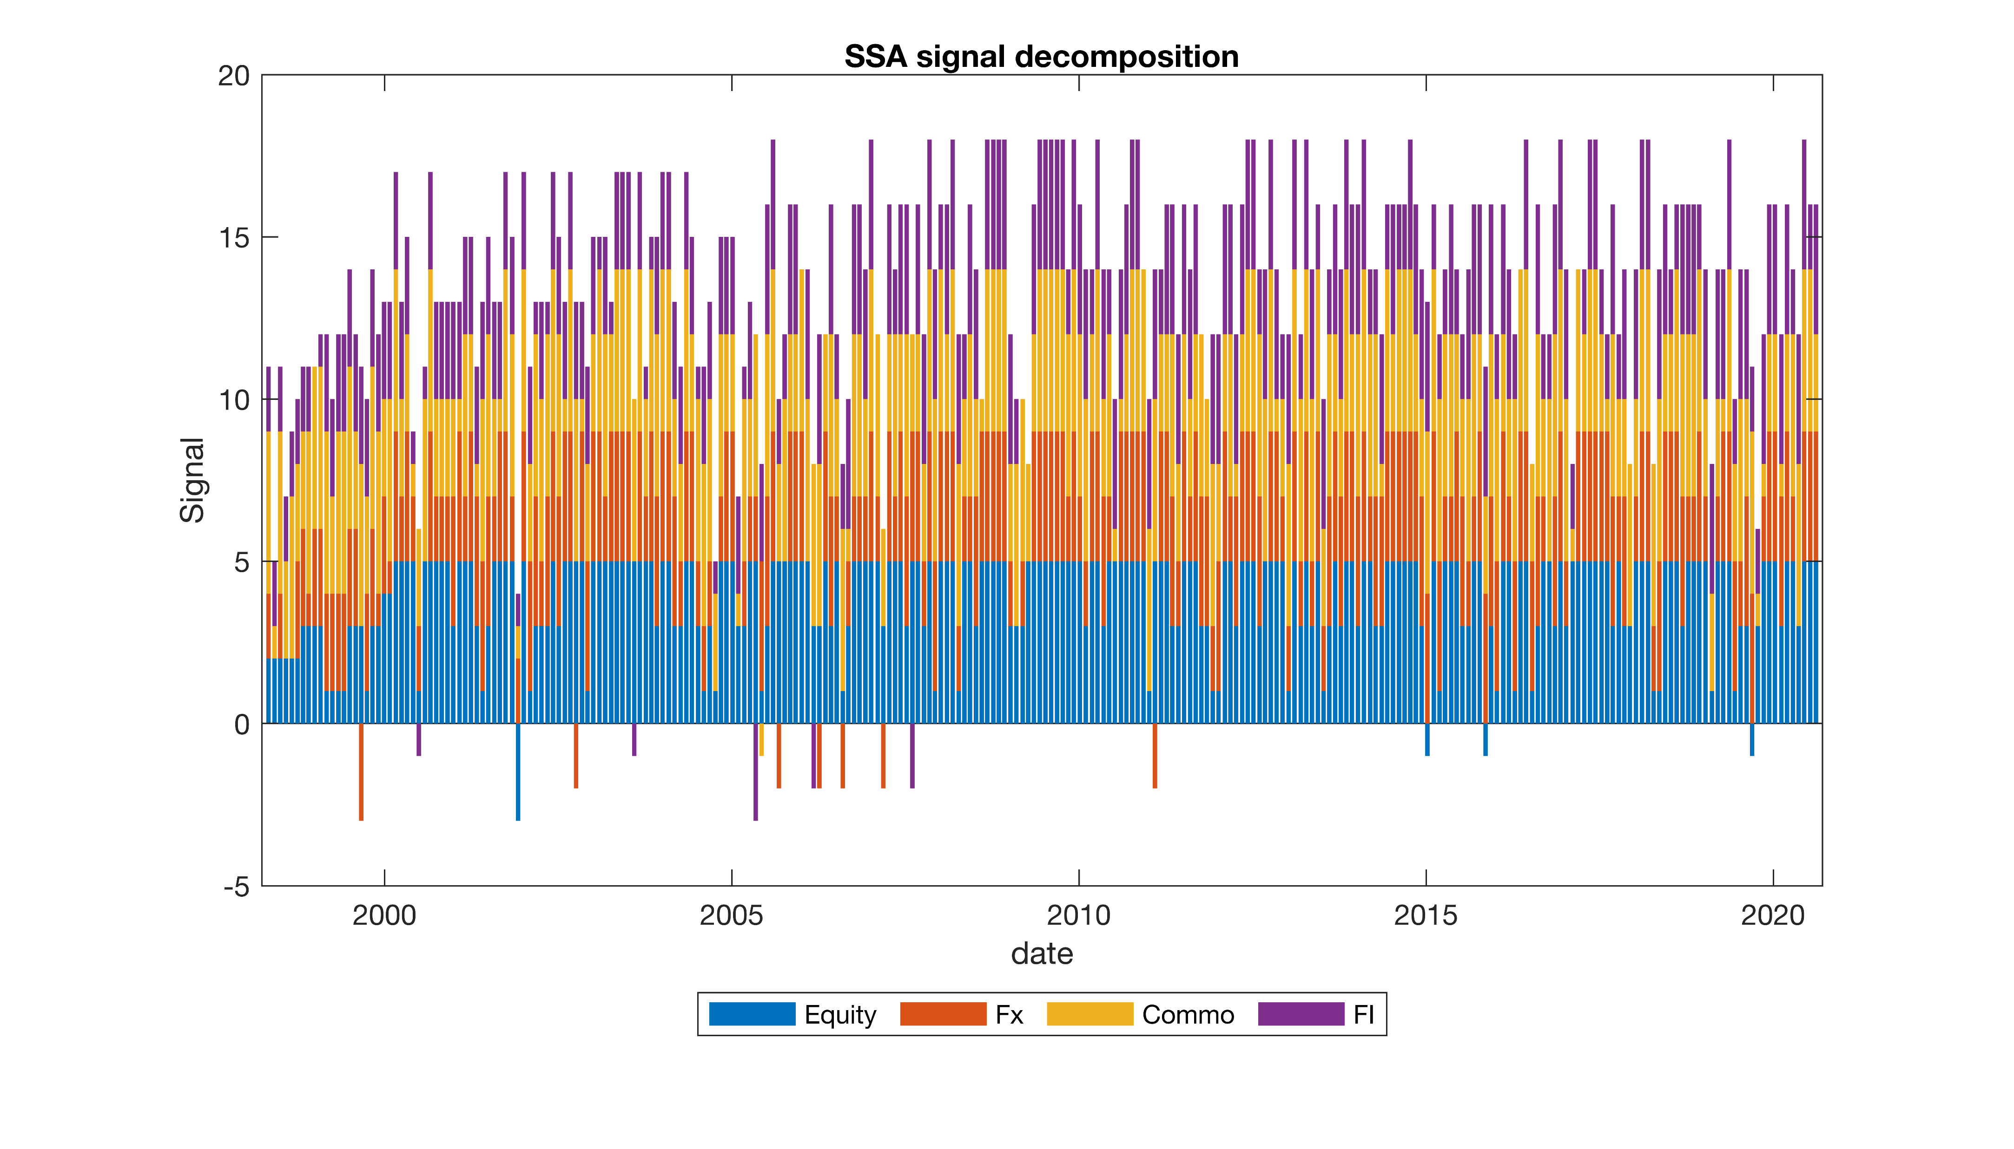
Results – SSA – Sensitivity Analysis
Maxime Borel & Benjamin Souane
QARM II – 17.12.2020

Slide 15

Results – SSA – Conclusion
Strong Performance
Robust to sensitivity analysis
Reduced Drawdown
Almost neutral relationship with correlation
Maxime Borel & Benjamin Souane
QARM II – 17.12.2020

Slide 16





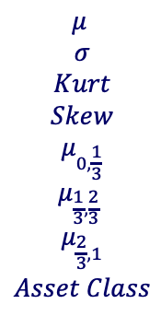
Results – SVM - Framework
Signal and assumptions
Signal computation
Main Assumptions & implementation
Trained on 10 years of data with RBF kernel
Score threshold : 20%
Length features : 90 days
$$\begin{aligned}\begin{aligned}μ \\ σ \\ Kurt \\ Skew \\ μ_{0,\frac{1}{3}} \\ μ_{\frac{1}{3},\frac{2}{3}} \end{aligned} \\ μ_{\frac{2}{3},1} \\ Asset Class\end{aligned}$$
$S_{t,i}^{SVM} if P ≥ T$
$S_{t,i}^{SVM}∈\{−1, 1\}$
Support Vector Machine
$0 otherwise$
Score($S_{t,i}^{SVM}$ = prediction)
$$T∈ℝ[0, 1]$$
Maxime Borel & Benjamin Souane
QARM II – 17.12.2020

Slide 17
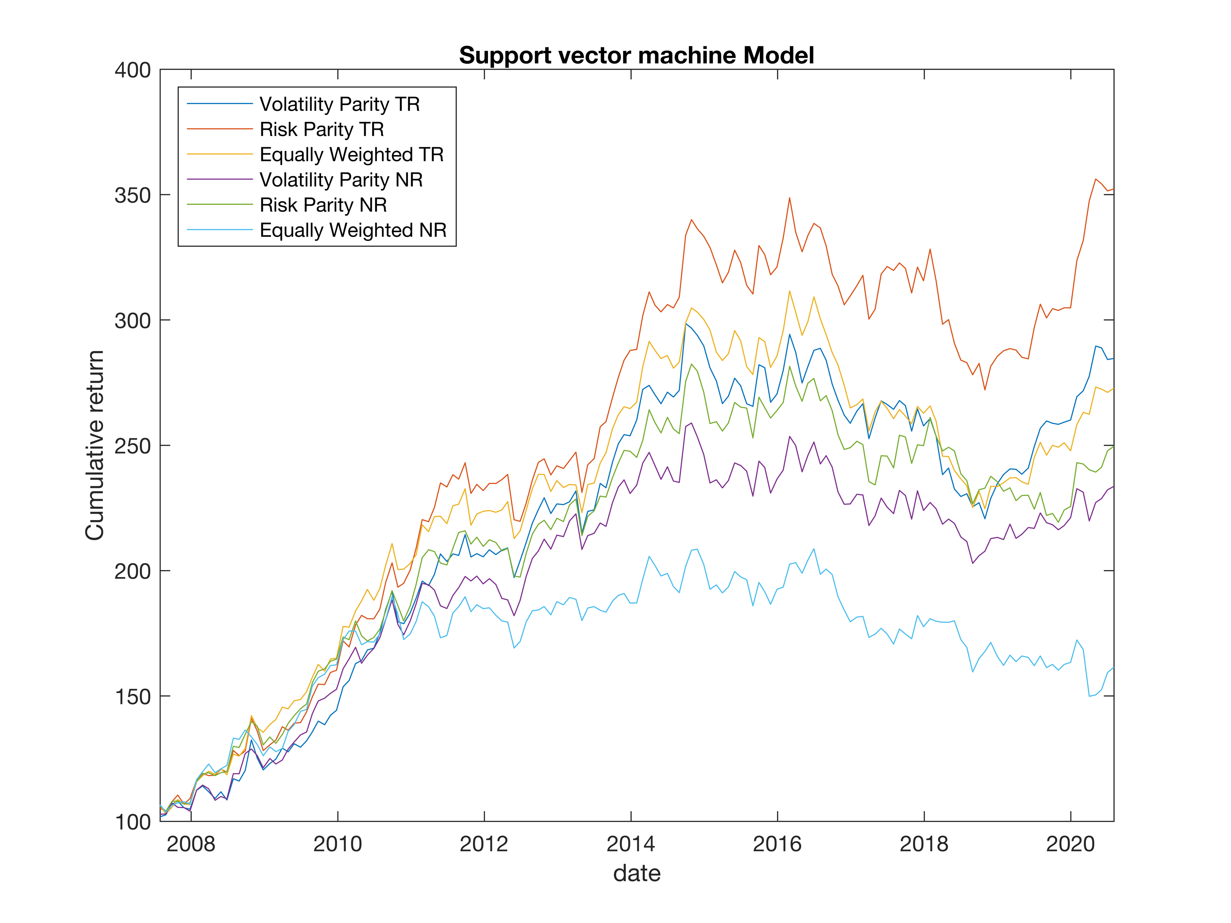
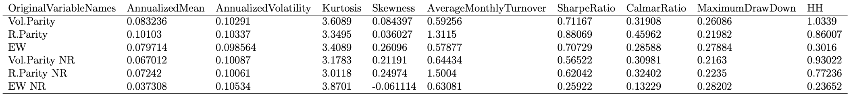
Results – SVM - Performance
Maxime Borel & Benjamin Souane
QARM II – 17.12.2020

Slide 18
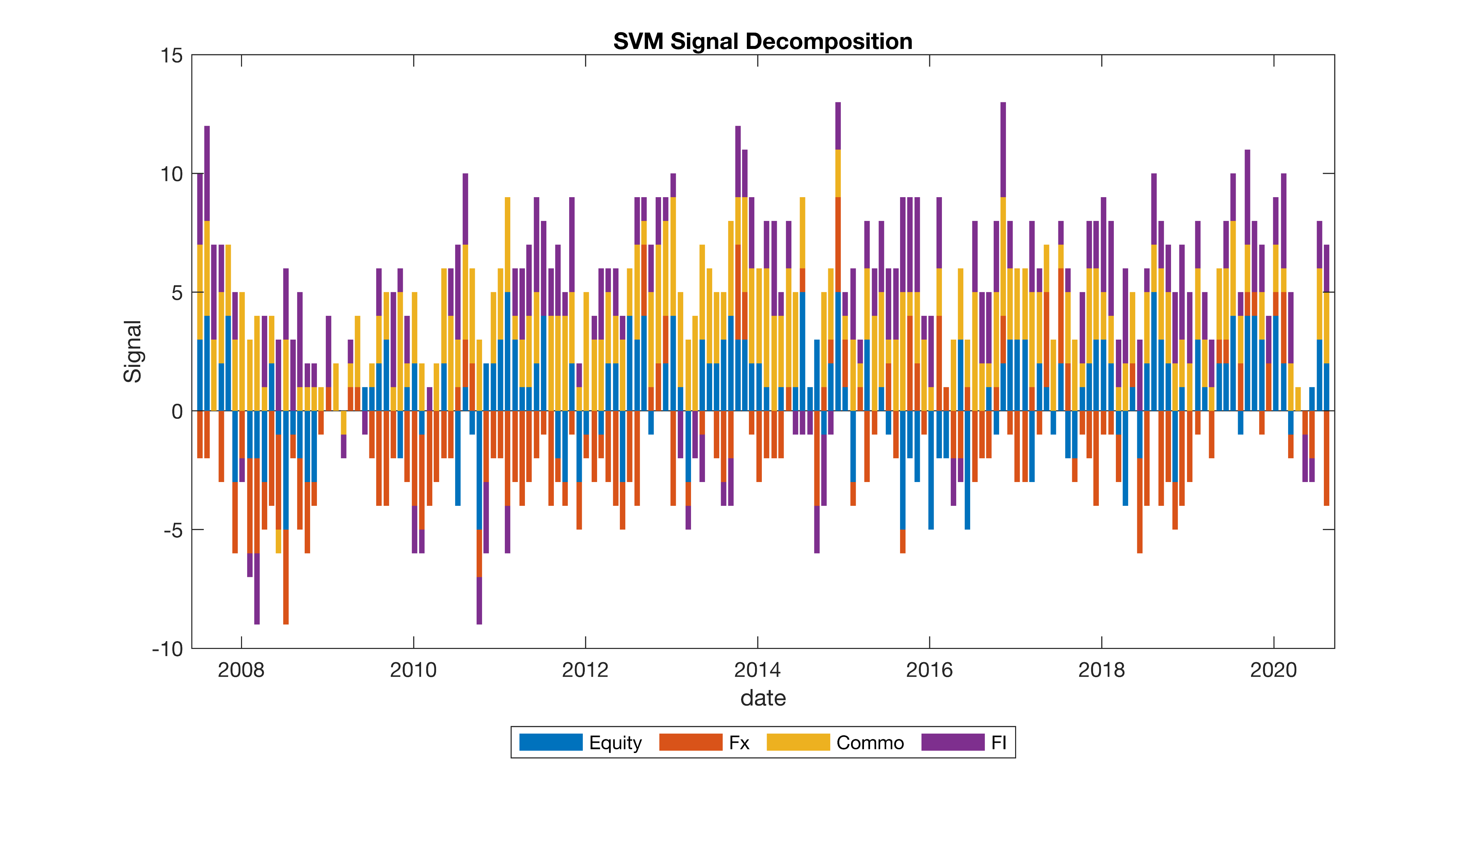
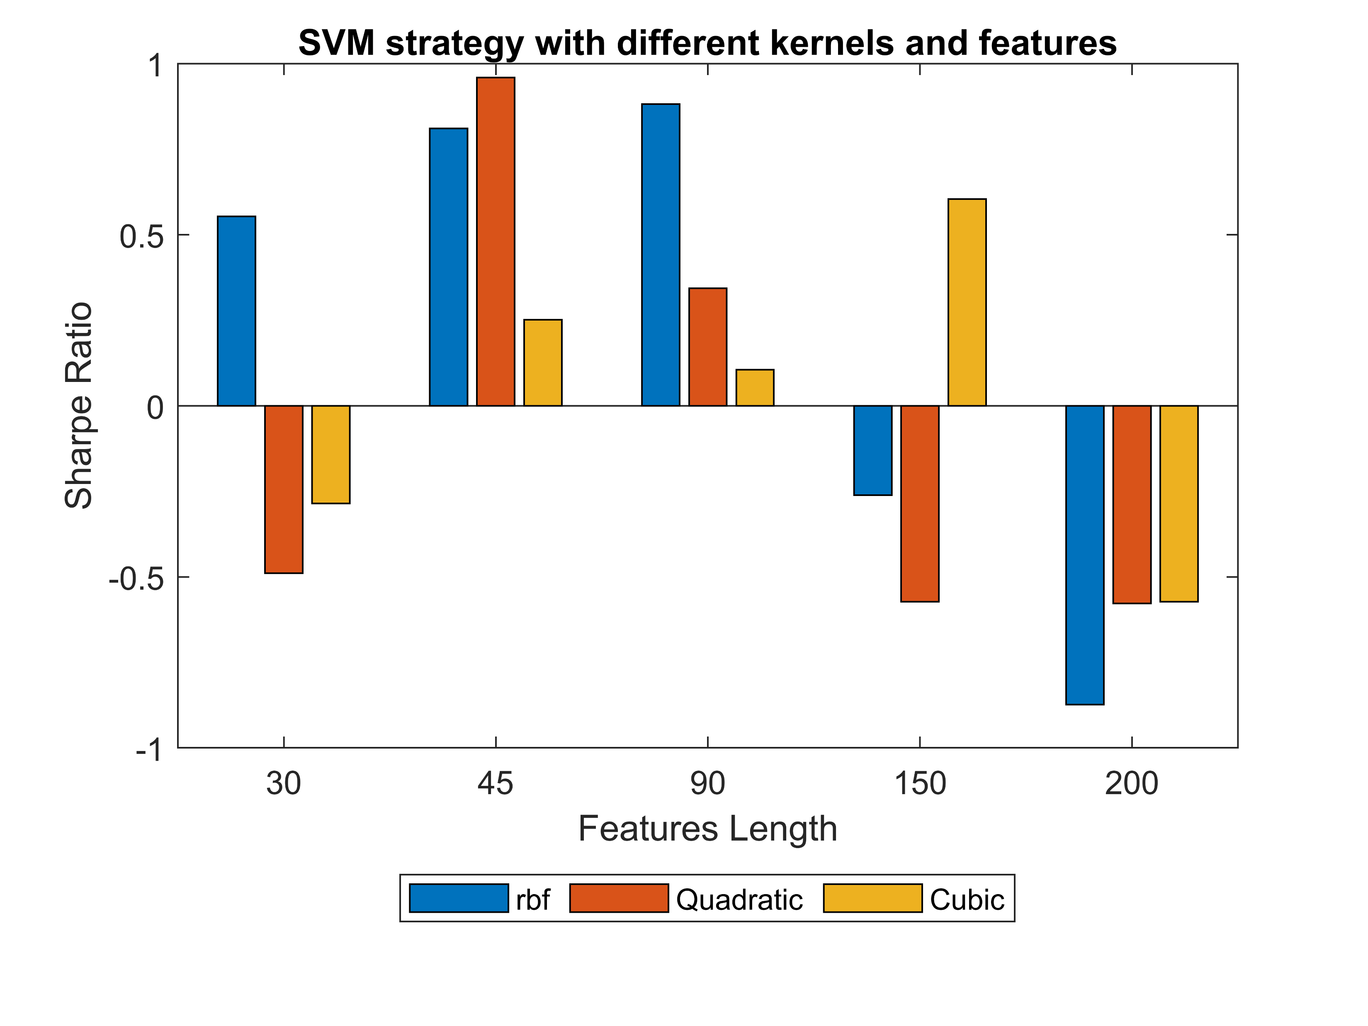
Results – SVM – Sensitivity Analysis
Maxime Borel & Benjamin Souane
QARM II – 17.12.2020

Slide 19

Results – SVM – Conclusion
Best Performance
Positive sensitivity to correlation
MDD Strongly Reduced
Benefits of “Buzz word”
Growing research on the subject
Maxime Borel & Benjamin Souane
QARM II – 17.12.2020

Slide 20








Limits and Improvements
Limits
Operational implementation
Hard to analyze
Sensitiveness of the models
Improvements
Combinaison of the models
Dynamically training the models
Improving Features
Maxime Borel & Benjamin Souane
QARM II – 17.12.2020
Notes:
M

Slide 21
References
X.Wang, A.Smith, R.Hyndman. “Dimension Reduction for Clustering Time Series Using Globl Characteristics”. In: Springer (2005).
T.Alexandrov. “A Method of trend extraction using singular spectrum analysis”. In: Statistical Journal 7.1 (2009), pp. 1–22.
Bruder, Dao, Richard and Roncalli. “Trend Filtering Methods for Momentum Strategies: Lyxor Asset Management”. In: (2011).
Ooi Moskowitz and Pedersen. “Time series momentum”. In: Journal of financial Economics 104 (2012), pp. 228–250. doi: 10.1016/j.jfineco.2011.11.003. url: doi:10.1016/j.jfineco.2011.11.003.
Baltas. “Trend-Following, Risk-Parity and the Influence of Correlations”. In: Risk Based and Factor Investing (2015).
Jamil Baz, Nick Granger, Campbell R. Harvey, Nicolas Le Roux and Sandy Rattray. “Dissecting Investment Strategies in the Cross Section and Time Series.” In: (2015). doi: 10.2139/ssrn.2695101. (Visited on ).
Xiong and Ibbotson. “Momemtum Acceleration and Reversal”. In: Journal of Investment Management 13.1 (2015), pp. 84–95.
Daniel and Moskowitz. “Momentum Crahses”. In: Journal of financial Economics 122 (2016), pp. 221–247. doi: 10.1016/j.jfineco.2015.12.002.
Levine and Pedersen. “Which Trend Is Your Friend?” In: Financial Analyst Journal 72.3 (2016), pp. 51–66.
Maxime Borel & Benjamin Souane
QARM II – 17.12.2020

Slide 22
References cont.
Yu and Webb. “CAN FUNDAMENTAL FACTORS ENHANCE THE PERFORMANCE OF TRADITIONAL MOMENTUM STRATEGIES?” In: Journal of Investment Management 14.4 (2016), pp. 28–43.
Federico Nucera. “Risk-Managed Momentum: The effect of leverage constraints”. In: (2017). url: https://ssrn.com/abstract=3008530.
Baltas and Kosowski. “Demystifying Time-series Momentum Strategies: Volatility Estimators, Trading Rules and Pairwise Correlations”. In: SSRN Electronic Journal (2019). doi: 10.2139/ssrn.2140091. url: https://ssrn.com/abstract=2140091
Michal Balcerak and Thomas Schmelzer. “Constructing trading strategy ensembles by classifying market states”. In: (2020). arXiv: 2012.03078 [q-fin.TR].
Antonacci. “Optimal Momentum: A Global Cross Asset Approach”. In: (). url: https://ssrn.com/abstract=1833722.
B. Hurst, Y.Ooi, L.Pedersen. “A Century of Evidence on Trend-Following Inesting”. In: (). url: https://ssrn.com/abstract=2993026.
Maxime Borel & Benjamin Souane
QARM II – 17.12.2020

Slide 23

Thank you
Questions ?
Notes:
LE QR c’est notre github

